Slide 1
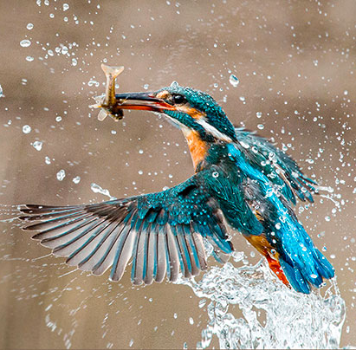
As Kingfishers Catch Fire
By Gerard Manly Hopkins
As kingfishers catch fire, dragonflies draw flame; As tumbled over rim in roundy wells Stones ring; like each tucked string tells, each hung bell's Bow swung finds tongue to fling out broad its name; Each mortal thing does one thing and the same: Deals out that being indoors each one dwells; Selves — goes itself; myself it speaks and spells, Crying What I do is me: for that I came.
I say more: the just man justices; Keeps grace: that keeps all his goings graces; Acts in God's eye what in God's eye he is — Christ — for Christ plays in ten thousand places, Lovely in limbs, and lovely in eyes not his To the Father through the features of men's faces.

Slide 5
